Slide 1
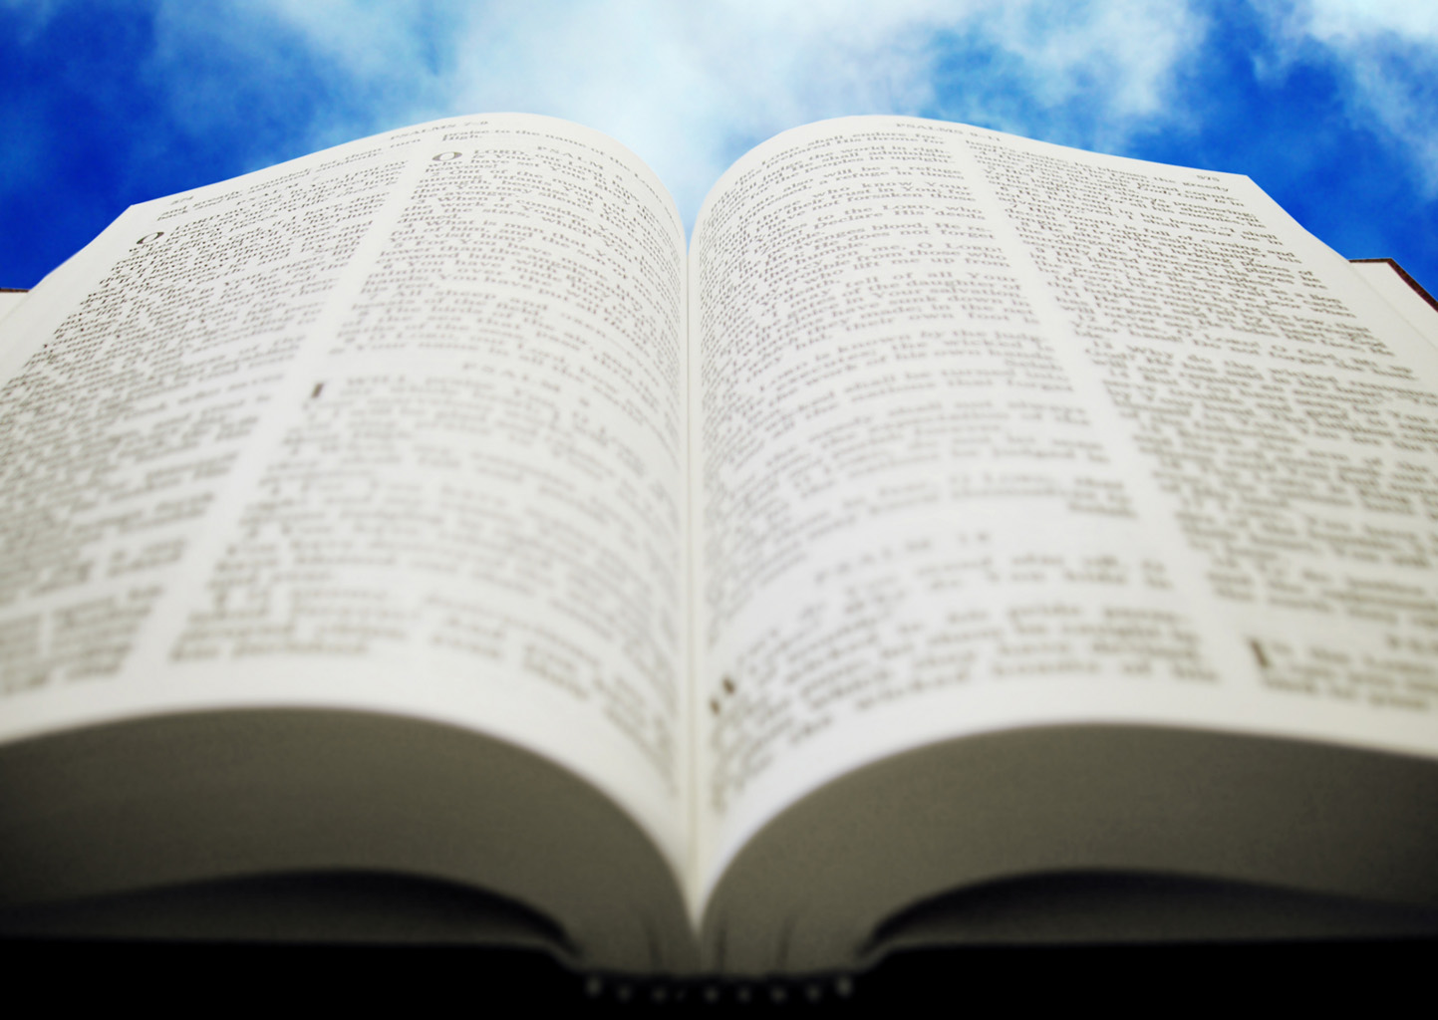
Welcome!
Sunday
Worship 9:30 AM
Sunday
Bible Class (Livestream) 5:00 PM
Wednesday
Bible Class (Livestream) 7:00 PM
www.SunsetchurchofChrist.net

Slide 2
Order of Service
Opening Prayer | Craig Foster
Song – | Chris Willis
Song – | Chris Willis
Lord’s Supper | Anthony Ward
Song – | Chris Willis
Lesson | Brian Haines
Song – | Chris Willis
Closing | Ryan Sollars
Psalm 40:3
He put a new song in my mouth,
A song of praise
to our God;
Many will see
and fear and will
trust in the LORD.

Slide 3
II Kings 5
1) Leprosy – dead and alive
2) Believing – a young girl offered hope
3) Absence of the prophet – only a command
4) Not the of water – the water is not the key
5) The power of obedience – obedience is the key
6) The moment of cleansing – after obedience
7) The desire to be holy – taking dirt the kingdom

Slide 4
Romans 6
1) Leprosy……………………………..
2) Believing …………………………..
3) Absence of the prophet …….
4) Not the of water ……………….
5) The power of obedience ……
6) The moment of cleansing ….
7) The desire to be holy …………
Notes:
Ro 10:10 For with the heart one believes unto righteousness, and with the mouth confession is made unto salvation.
Eph 2:1 ¶ And you He made alive, who were dead in trespasses and sins,
Tit 3:5 not by works of righteousness which we have done, but according to His mercy He saved us, through the washing of regeneration and renewing of the Holy Spirit,

Slide 5
Romans 6
1) Leprosy…………………………….. Dead in sin
2) Believing …………………………..
3) Absence of the prophet …….
4) Not the of water ……………….
5) The power of obedience ……
6) The moment of cleansing ….
7) The desire to be holy …………
Notes:
Ro 10:10 For with the heart one believes unto righteousness, and with the mouth confession is made unto salvation.
Eph 2:1 ¶ And you He made alive, who were dead in trespasses and sins,
Tit 3:5 not by works of righteousness which we have done, but according to His mercy He saved us, through the washing of regeneration and renewing of the Holy Spirit,

Slide 6
Romans 6
1) Leprosy…………………………….. Dead in sin
2) Believing ………………………….. With the heart
3) Absence of the prophet …….
4) Not the of water ……………….
5) The power of obedience ……
6) The moment of cleansing ….
7) The desire to be holy …………
Notes:
Ro 10:10 For with the heart one believes unto righteousness, and with the mouth confession is made unto salvation.
Eph 2:1 ¶ And you He made alive, who were dead in trespasses and sins,
Tit 3:5 not by works of righteousness which we have done, but according to His mercy He saved us, through the washing of regeneration and renewing of the Holy Spirit,

Slide 7
Romans 6
1) Leprosy…………………………….. Dead in sin
2) Believing ………………………….. With the heart
3) Absence of the prophet ……. Faith by hearing
4) Not the of water ……………….
5) The power of obedience ……
6) The moment of cleansing ….
7) The desire to be holy …………
Notes:
Ro 10:10 For with the heart one believes unto righteousness, and with the mouth confession is made unto salvation.
Eph 2:1 ¶ And you He made alive, who were dead in trespasses and sins,
Tit 3:5 not by works of righteousness which we have done, but according to His mercy He saved us, through the washing of regeneration and renewing of the Holy Spirit,

Slide 8
Romans 6
1) Leprosy…………………………….. Dead in sin
2) Believing ………………………….. With the heart
3) Absence of the prophet ……. Faith by hearing
4) Not the of water ………………. Buried with Christ
5) The power of obedience ……
6) The moment of cleansing ….
7) The desire to be holy …………
Notes:
Ro 10:10 For with the heart one believes unto righteousness, and with the mouth confession is made unto salvation.
Eph 2:1 ¶ And you He made alive, who were dead in trespasses and sins,
Tit 3:5 not by works of righteousness which we have done, but according to His mercy He saved us, through the washing of regeneration and renewing of the Holy Spirit,

Slide 9
Romans 6
1) Leprosy…………………………….. Dead in sin
2) Believing ………………………….. With the heart
3) Absence of the prophet ……. Faith by hearing
4) Not the of water ………………. Buried with Christ
5) The power of obedience …… That doctrine
6) The moment of cleansing ….
7) The desire to be holy …………
Notes:
Ro 10:10 For with the heart one believes unto righteousness, and with the mouth confession is made unto salvation.
Eph 2:1 ¶ And you He made alive, who were dead in trespasses and sins,
Tit 3:5 not by works of righteousness which we have done, but according to His mercy He saved us, through the washing of regeneration and renewing of the Holy Spirit,

Slide 10
Romans 6
1) Leprosy…………………………….. Dead in sin
2) Believing ………………………….. With the heart
3) Absence of the prophet ……. Faith by hearing
4) Not the of water ………………. Buried with Christ
5) The power of obedience …… That doctrine
6) The moment of cleansing …. A like resurrection
7) The desire to be holy …………
Notes:
Ro 10:10 For with the heart one believes unto righteousness, and with the mouth confession is made unto salvation.
Eph 2:1 ¶ And you He made alive, who were dead in trespasses and sins,
Tit 3:5 not by works of righteousness which we have done, but according to His mercy He saved us, through the washing of regeneration and renewing of the Holy Spirit,

Slide 11
Romans 6
1) Leprosy…………………………….. Dead in sin
2) Believing ………………………….. With the heart
3) Absence of the prophet ……. Faith by hearing
4) Not the of water ………………. Buried with Christ
5) The power of obedience …… That doctrine
6) The moment of cleansing …. A like resurrection
7) The desire to be holy ………… Walking in Life
Notes:
Ro 10:10 For with the heart one believes unto righteousness, and with the mouth confession is made unto salvation.
Eph 2:1 ¶ And you He made alive, who were dead in trespasses and sins,
Tit 3:5 not by works of righteousness which we have done, but according to His mercy He saved us, through the washing of regeneration and renewing of the Holy Spirit,

Slide 13
Making a Choice
"My father, if the prophet had told you to do something great, would you not have done it? How much more then, when he says to you, 'Wash, and be clean'?“
'And now why are you waiting? Arise and be baptized, and wash away your sins, calling on the name of the Lord.‘ Acts 22:16

Slide 14
Following God’s Path
Hear and Believe – Acts 15:7
Confess Jesus as Lord – Romans 10:9
Repentance from sin – Acts 2:38
Baptism into Christ – Romans 6:3-5
Faithful in life – Revelation 2:10

